Slide 1

WE MAKE HOME POSSIBLE
Presented by,
Monika Saradha

Slide 2
PROFIT!!!
$466.5 million potentially as per 2022.
Loss due to bad loans: $4.07 billion
By means of implementing the predictive model to avoid purchasing loans that are likely to go delinquent.
Objective: Improve Freddie Mac's purchasing decisions to create higher-priced loan bundles.
Strategy: Predict loans that are likely to go delinquent within the first two years.

Slide 3
Recommendations
Vital Variable | Conservative Approach | Liberal Approach
Credit Score | Set threshold at 750 and above. | Consider scores down to 650 with additional safeguards.
Original Interest Rate | Offer rates competitive with the industry, leaning towards lower risk borrowers. | Implement dynamic pricing based on borrower risk profile.
Original DTI Ratio | Limit loans with DTI ratio exceeding 36%. | Extend to DTI of 43% with higher interest rates or additional insurance.
Original UPB | Set stricter limits on loan amounts for riskier borrowers. | Offer higher loan amounts with protective measures like higher interest rates.
Original CLTV | Require larger down payment (lower CLTV). | Allow smaller down payment with private mortgage insurance or higher interest rates.
Number of Borrowers | Require all borrowers to meet stringent credit score criteria. | Allow flexibility if one borrower has a strong credit profile.
Property State Frequencies | Ensure geographically diverse loan portfolio. Limit exposure in unstable regions. | Monitor regional economic indicators; adjust exposure accordingly.

Slide 4
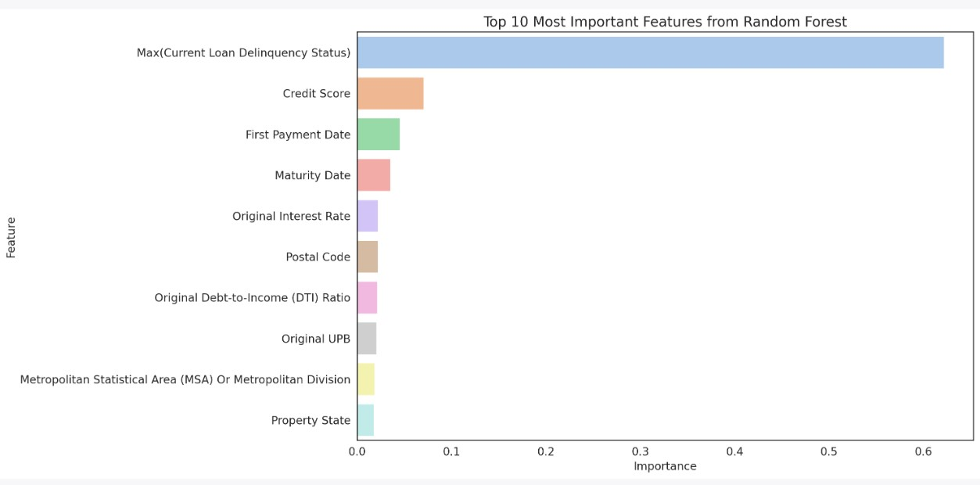
Featured Variables

Slide 5
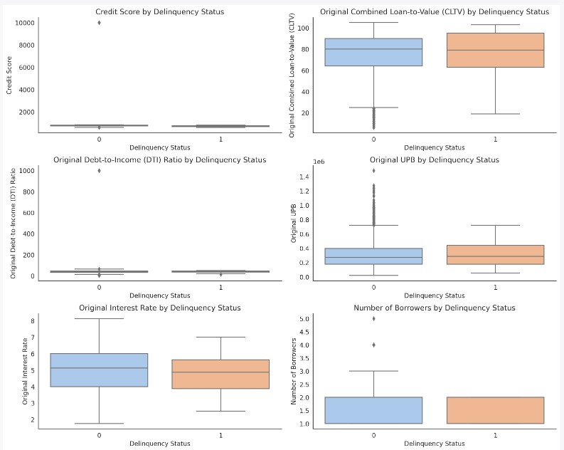
Relationship between key variables and delinquency status

Slide 6
Financials
Sales/Revenue: Dip in 2020 and 2021; rebound in 2022.
Operating Income: Spike in 2019; stable growth thereafter.
Net Income: Peak in 2021; slight dip in 2022 but still high.
Changes in Working Capital: Fluctuations over years; minor dip in 2022.
Net Operating Cash Flow: Surge in 2021; slight decrease in 2022.

Slide 7
Conclusion
Historical Financial Data:
The Net Income for Freddie Mac for the year 2022 was $9.33 Billion.
Modeling Insights:
Our Decision Tree model predicted with approximately 90% accuracy, while the Random Forest model predicted with an accuracy of about 92%.
We previously determined that by avoiding loans likely to go delinquent, Freddie Mac could potentially avoid 5% of bad loans.
The savings of $466.5$466.5 million represents approximately 5% of the net income for 2022.

Slide 8
Thank You!
WE MAKE HOME POSSIBLE

